Slide 1
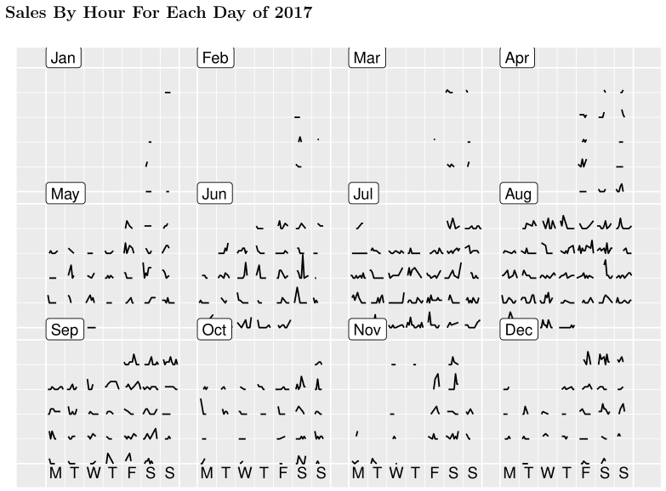
Splash Staffing Profiles
Grey – Jan-Apr
Green – May, Jun, Sep
Blue – Jul-Aug
Pink – Oct-Dec

